Slide 1

Project Title: Crater Detection Using Computer Vision Techniques
Domain: Computer Vision
Zeroth Review
Course Code: CS7610
Course Title: Capstone Project
Guide Name:
Register Number: 23MSP3068
Name: Dharshani A.
Date: 29-05-2024

Slide 2
Name of the University: University of Michigan-Dearborn
Program Name: MS in Artificial Intelligence
Faculty Name: Dr. Jaerock Kwon Link to Professor's University Profile
Domain: Computer Vision
Current Topic: Computer Vision, Agricultural Robotics

Slide 3
Problem Statement
Planetary exploration has significantly advanced our understanding of celestial bodies within our solar system. Craters, formed by the impact of meteoroids, asteroids, and comets, are among the most prominent geological features on these surfaces. Analyzing these craters provides critical insights into the history and geology of planets and moons. However, manually identifying and cataloging craters from vast amounts of high-resolution imagery is time-consuming and prone to human error. Therefore, automated crater detection using computer vision techniques has become a crucial area of research.

Slide 4
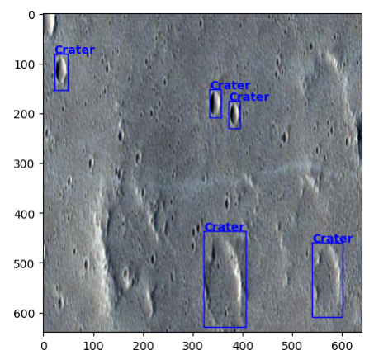
Dataset
Source of the Dataset: Kaggle Link to Dataset
No. of Observations: 143 images – 98 training images, 26 validation images, 19 testing images
Images: Planetary surface images containing craters
Labels: Annotations of crater locations in the images (bounding boxes)
Screenshot of the dataset:

Slide 5
Review of Related Literature
Base Paper:
Khanzada, F.K.; Delavari, E.; Jeong, W.; Cho, Y.S.; Kwon, J. “Comparative Study on Simulated Outdoor Navigation for Agricultural Robots.” Sensors 2024, 24, 2487. Link to Paper
Paper I:
Citation: Giannakis, I., Bhardwaj, A., Sam, L., & Leontidis, G. (2023). Deep learning universal crater detection using Segment Anything Model (SAM). arXiv. Retrieved from Link to paper
Paper II:
Citation: (2023). Deep Learning based Systems for Crater Detection: A Review. arXiv. Retrieved from Link to paper
Paper III:
Citation: Xian, L., & Zhang, W. (2021). Semi-Supervised Deep Learning for Lunar Crater Detection Using CE-2 DOM. Remote Sensing, 13(14), 2819. Link to paper
Paper IV:
Citation: Zhang, W. (2023). YOLO-Crater Model for Small Crater Detection. Remote Sensing, 15(20), 5040. Link to paper

Slide 6
Comparison Between Proposed Research and Base Paper
Feature/Aspect | Proposed Research | Base Paper
Objective | Develop and compare computer vision techniques for detecting craters in planetary surface images. | Compare different simulated outdoor navigation techniques for agricultural robots.
Domain | Computer Vision, Planetary Science | Agricultural Robotics, Computer Vision
Primary Focus | Accurate identification and localization of craters in various conditions to aid planetary exploration and research. | Evaluating the performance, accuracy, and efficiency of various navigation algorithms for real-world application in agricultural settings.
Key Techniques | - Deep learning (Faster R-CNN, YOLO) | - Simulation environments
Dataset | - Planetary surface images with annotated craters | - Simulated outdoor environments for agricultural robots
Data Sources | - High-resolution planetary images from missions like Lunar Reconnaissance Orbiter (LRO), Mars Reconnaissance Orbiter (MRO) | - Custom simulation environments replicating agricultural fields
Evaluation Metrics | - Precision, recall, F1-score, Intersection over Union (IoU) | - Accuracy of navigation, obstacle avoidance success rate, computational efficiency
Challenges Addressed | - Variability in crater appearance (size, shape, degradation) | - Navigation in diverse and unpredictable agricultural environments
Impact | - Improved planetary mapping, aiding scientific research, and enhancing autonomous rover capabilities. | - Improved efficiency and reliability of agricultural robots, enhancing agricultural productivity and reducing labor costs.
Key Contributions | - Development of robust crater detection models applicable to different planetary surfaces. | - Insights into the most effective navigation techniques for real-world agricultural robot deployment.
Technological Requirements | - High-performance GPUs for training deep learning models, computer vision libraries (OpenCV, PyTorch, TensorFlow) | - Simulation software, robotic platforms, and potentially GPU acceleration for running complex simulations.
Research Outcomes | - Creation of accurate and efficient crater detection models, benchmark datasets for future research. | - Comparative analysis of navigation algorithms, recommendations for best practices in agricultural robot navigation.

Slide 7
Impact of the Proposed Research
The proposed research aims to improve the accuracy and efficiency of crater detection in planetary images using advanced computer vision techniques.
Accurate crater detection is crucial for planetary mapping, exploration, and research.
The results of this project could enhance the capabilities of autonomous planetary rovers and aid scientists in studying the geological history of planetary bodies.

